Slide 1
Student Union Election 2021/2022
As part of Lambeth College’s commitment to Democracy, one of the key British Values, each year learners are asked to democratically elect a student body to represent them.
The Lambeth College Student Union isn’t unique – it’s part of the NUS (National Union of Students) - that represent all universities and colleges in the country.
We have an excellent line up of candidates who have put themselves forward for election to the Student Union.
This year’s candidates are….

Slide 2
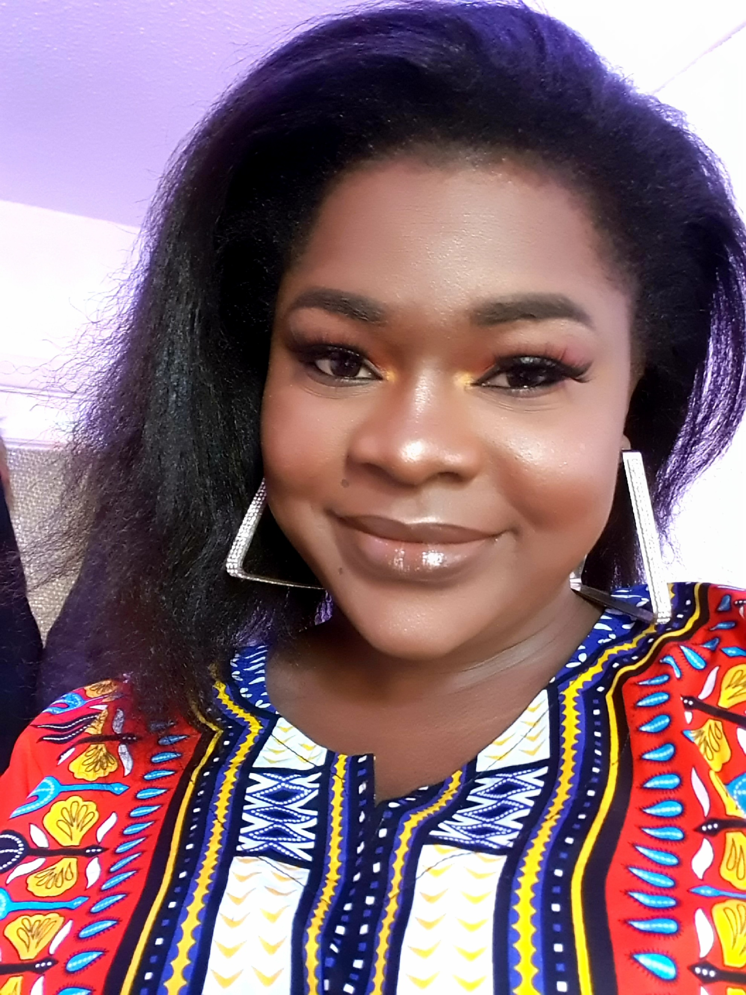
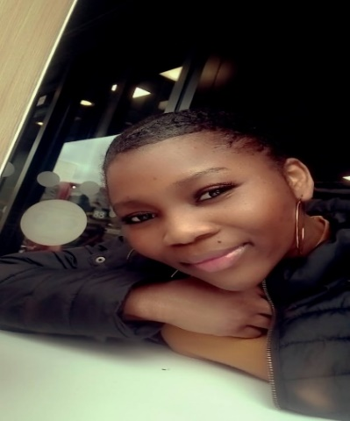
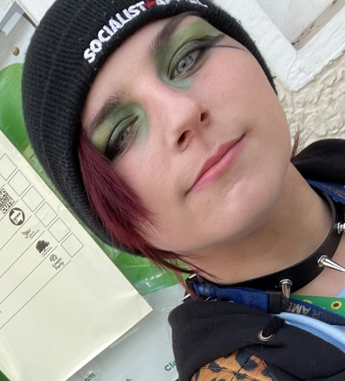
Blessing-President
I am competent, reliable, trustworthy and I give a 100% commitment.
I am a people person and I communicate well
I am also very approachable and eager to help where I can
Moriam-President
I am confident with my guidance and leadership qualities and skills
I am an efficient, hard-working, and trusted person. I work with energy
I will campaign for a common Room with lunch time events & entertainment
Jodie-President
I want to create a more positive environment for the students
I am a course rep and an ambassador I have experience on how to run things and give students the voice they need to be heard.
I will create space for students to chill in during lunch/break times

Slide 3
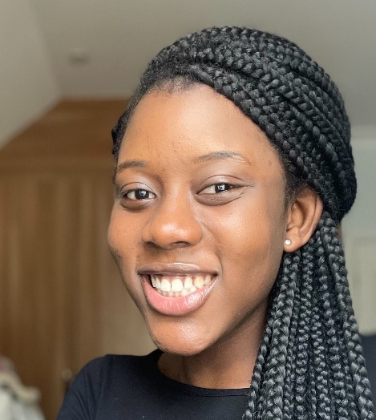
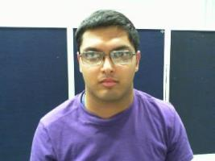
Lovia -President
I am trustworthy and always focus on what is ahead of me
Take a lead nationally on issues that affect our student body at Lambeth College.
I will endeavour to listen to your opinions and the things you would like to see changed.
Modou -President
I want to build a lovely and secure community for this generation and the next one coming.
I want to help and influence every student to come out of their
comfort zone and do better.
I have the ability to improve the welfare and lifestyle of students.
Luke -Vice President
I am a kind, caring and reliable person. I am easy to approach and talk to
I would like to organise a chill out room where students can socialise at break and lunch time
I am a good team player and work well in a team.

Slide 4
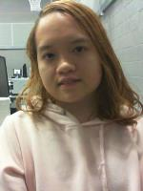
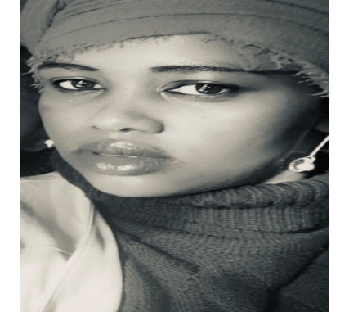
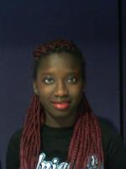
Klaine-Clapham Centre Representative
I am familiar with all the staff and students and I know the College well
I have a 100% attendance and punctuality, I have time to commit to making the College a better place
I am currently a course representative and represent my group well.
Khadija-Disability Champion
I am interested in representing the Students Voice at Lambeth College
I would like to make the College a fairer, equal and inclusive place for all students and put their concerns and suggestions into action, in particular, students with disabilities and special needs.
I am a creative and positive person and always want the best for others.
Regina-Events & Entertainment Champion
Develop innovative series of Events and Entertainment aimed at getting more students involved
Develop educational events in the form of entertainment Use this medium to bridge the gap of social inclusion and identify talents and create a formidable forum for them

Slide 5
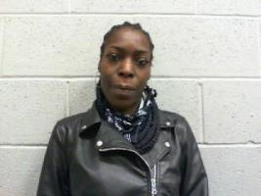
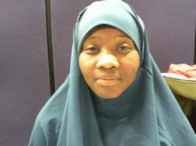
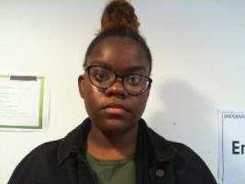
Nadia -Welfare & Diversity Champion
Renata- LGBTQ Champion
I am efficient, helpful and confident
I am able to make a difference in the lives of all students
I am determined to represent and advocate for the welfare of all students, especially those who are in minority groups
I am driven and have determination and take an interest in the welfare and wellbeing of all students
I thrive for equality for all and will ensure that there are services in place that will allow students to enjoy their learning experience.
I will take your concerns, ideas and suggestions and do my best to action them
Bendicta- General Secretary
I am applying for the position of General Secretary because I am efficient and like to organise a system to ensure that things go to plan
I will ensure that all students have access to information that they need and I will actively promote all activities and events.
I am interactive and open to ideas, always willing to learn and creative in bringing new ideas forward

Slide 6
Lambeth College Student Union Election 2021/2022
Take part in the election, make a difference, support your fellow learners and vote today!
https://forms.office.com/r/c2V8WbBBJe
Online voting opens Monday 17th May at 9am and closes on May 28th at 5pm

Slide 7
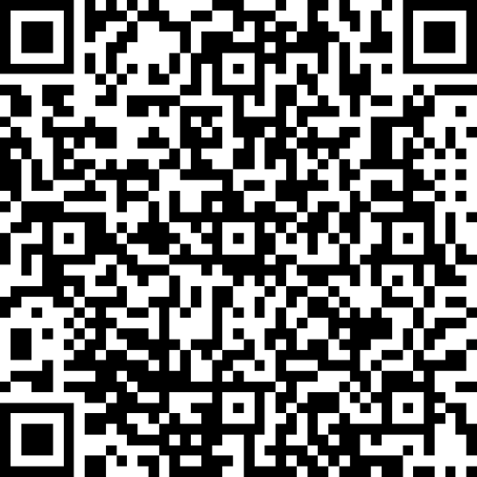
Lambeth College Student Union Election 2021/2022
Take part in the election, make a difference, support your fellow learners and vote today!
Online voting opens Monday 17th May at 9am and closes on May 28th at 5pm

