Slide 1
CONGRATULATIONS!! Meet your Lambeth College Student Union 2021/2022

Slide 2
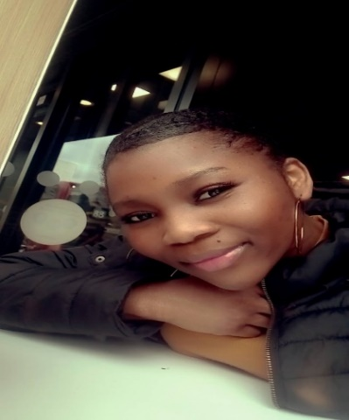
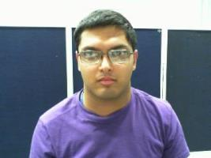
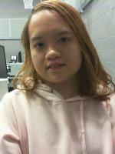
Klaine An Camposagrado Senador Clapham Centre Representative
Moriam Omolabake Folawiyo- President
Luke Newton-Vice President

Slide 3
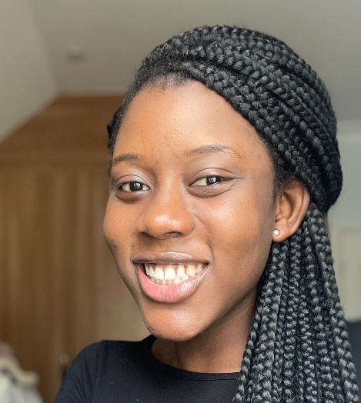
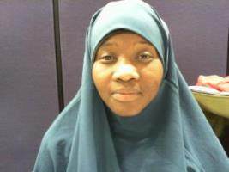
Lovia Asantewaa-Secretary
Treasurer-Modou Diop
Nadia Mohammed
Welfare & Diversity Champion

Slide 4
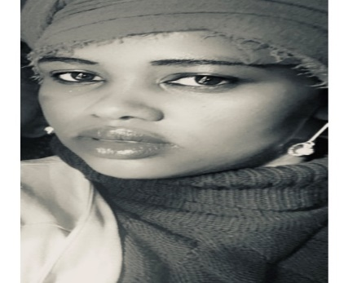
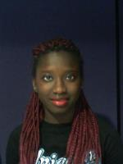
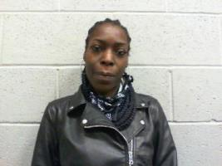
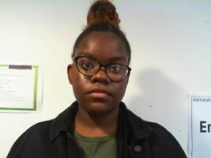
Disability Champion Khadija Gebo
Regina Davies
Events & Entertainment Champion
Renata Edwards- LGBTQ Champion
Benedicta Ellis- Media & Marketing Champion

Slide 5
Meet your Lambeth College Student Union 2021/2022
President
Moriam Omolabake Folawiyo

Slide 6
Meet your Lambeth College Student Union 2021/2022
Vice President
Luke Newton

Slide 7
Meet your Lambeth College Student Union 2021/2022
Clapham Centre Representative
Klaine An Camposagrado Senador

Slide 8
Meet your Lambeth College Student Union 2021/2022
Secretary
Lovia Asantewaa

Slide 9
Meet your Lambeth College Student Union 2021/2022
Treasurer
Modou Diop

Slide 10
Meet your Lambeth College Student Union 2021/2022
Disability Champion
Khadija Gebo

Slide 11
Meet your Lambeth College Student Union 2021/2022
Welfare & Diversity Champion
Nadia Mohammed

Slide 12
Meet your Lambeth College Student Union 2021/2022
Events & Entertainment Champion
Regina Davies

Slide 13
Meet your Lambeth College Student Union 2021/2022
LGBTQ Champion
Renata Edwards

Slide 14
Meet your Lambeth College Student Union 2021/2022
Media & Marketing Champion
Benedicta Ellis

